Slide 1
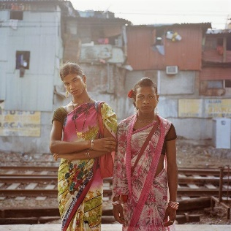
Socio-economic inclusion of Transgender Community through Smart interventions in India
Presented At:
FOSS4G KOREA 2020
12-13 Nov
Beyond Time & Space
Presented By:
Sakshi Dhruve
Maulana Azad National Institute of Technology, Bhopal, India

Slide 2
Smart City Plan (SCP)
The Smart City Plan (SCP)_two primary components_Area Base Development and Pan City Development
Area Base Development_to be limited to a specific area
Strategic components are:
_City improvement (Retrofitting)
Planning in an existing built-up area to achieve smart city objectives, along with other objectives, to make the existing area more efficient and livable.
_City renewal (Redevelopment)
Replacement of the existing built-up environment and enable co-creation of a new layout with enhanced infrastructure using mixed land use and increased density.
_City extension (Greenfield development)
Smart Solutions in a previously vacant area using innovative planning, plan financing and plan implementation tools.
Pan City Development_to be imposed across the city
Smart Solutions are applied covering larger parts of the city.
http://smartcities.gov.in/content/innerpage/strategy.php
Socio-economic inclusion of Transgender Community through Smart interventions in India

Slide 3
Transgender Community
“The transgender are individuals of any age or sex whose personality, attitude, appearances, behaviour and personal characters differ from stereotypes. It means they differ in identity on how men and women are supposed to be.”

Slide 4
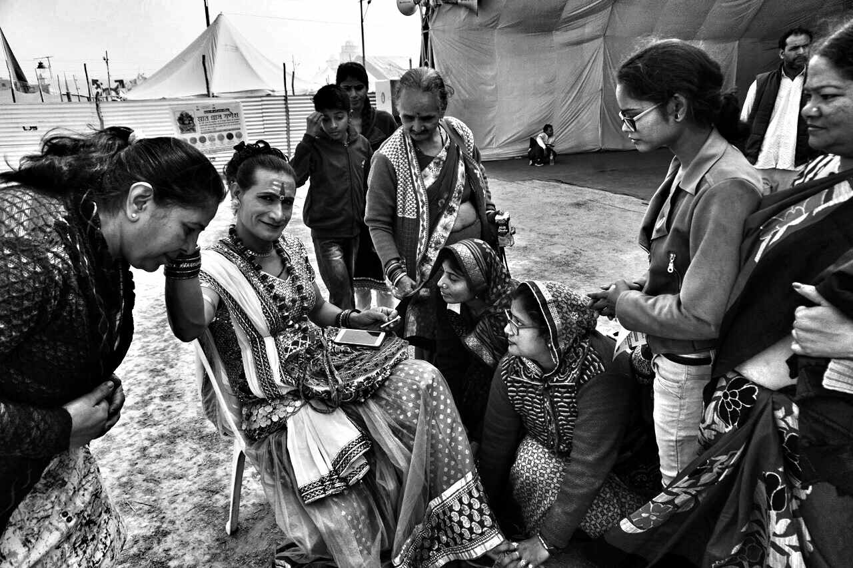
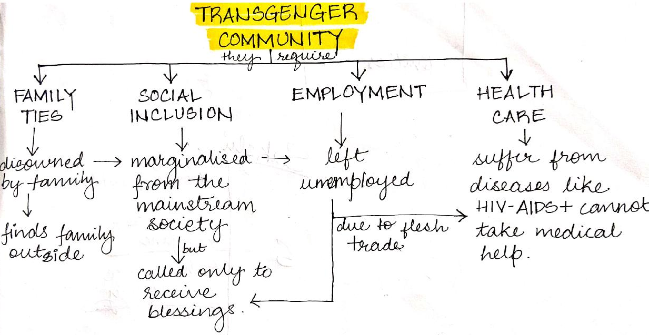
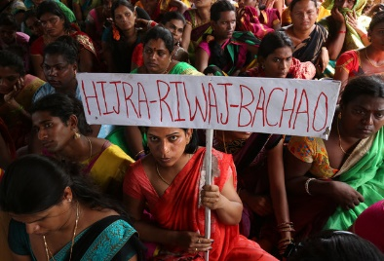

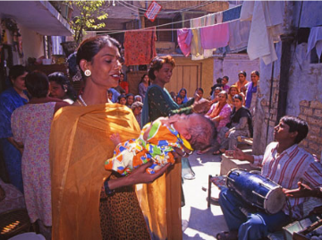


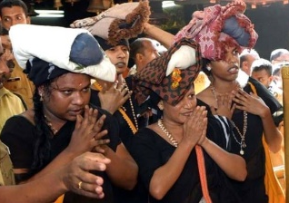
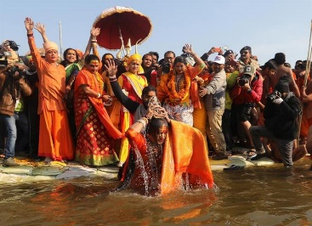
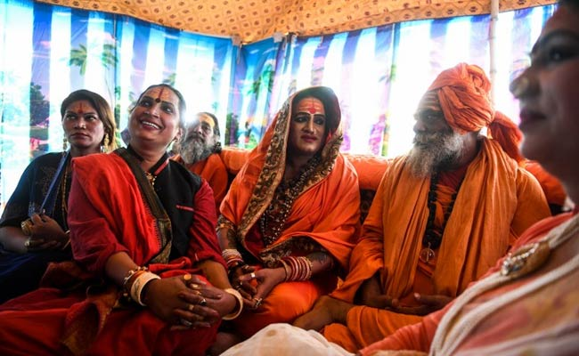
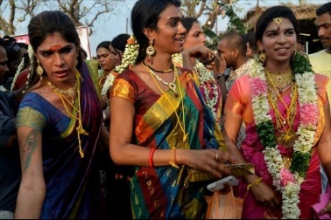
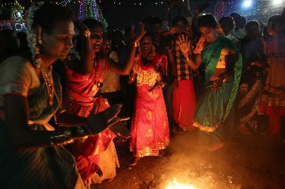
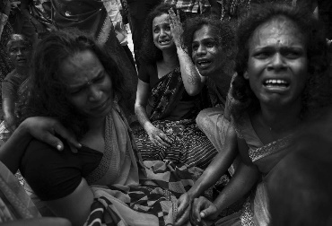
LIFESTYLE AND STRUGGLE FOR MONEY
1. Fighting for their rights.
2. Begging money at Railways station.
3. Blessing at ceremonies.
In 2014, after the Supreme Court of India pronounced them as `third gender’, they still face discrimination and are abused. India has become home for the three genders but not in Indian societies.
1
2
3
SOCIAL AND RELIGIOUS ACTIVITIES
4. Offering prayers at the Sabarimala Temple, Kerala.
5. Holy bath at Kumbh Mela
6. Religious meetings.
4
5
6
Struggling to make an identity.
TRANSGENDER FESTIVAL AT KOOVAGAM TAMIL NADU
According to, Indian Census 2011 there are total of 4.8 lakh transgender inhabitants.
7. Miss Koovagam beauty pageant.
8. Marriage ceremony and celebration
9. Widowhood ceremony and mourning.
7
8
9

Slide 5
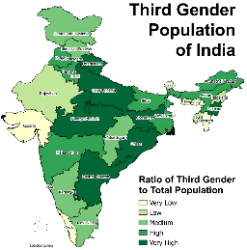
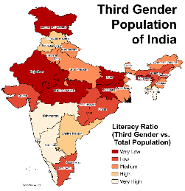
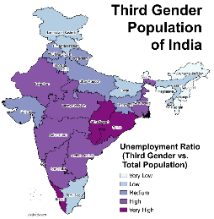
Facts And Figures
Map 1: Ratio of third gender population to total population.
Map 2: Ratio of literacy ratio of third gender to total population.
Map 3: Ratio of unemployment ratio of transgender to total population.
Source: https://medium.com/@ashvenkat/counting-the-third-gender-aafe7e858e07

Slide 6
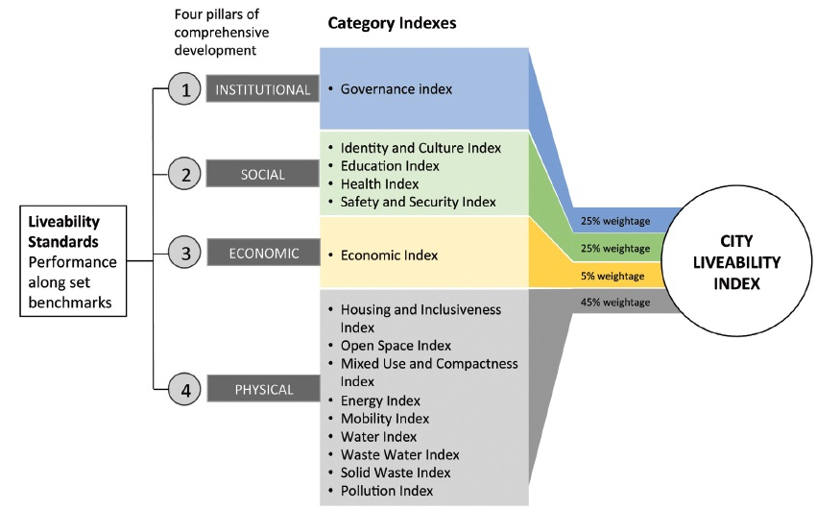
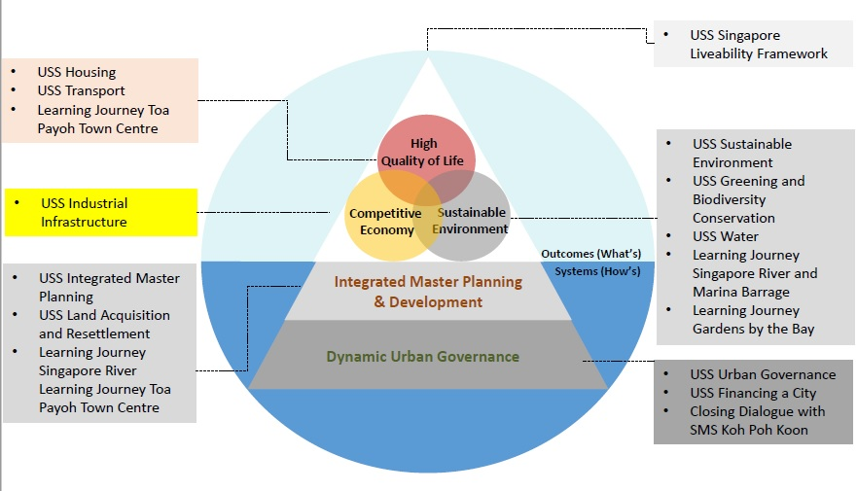
Livability Frameworks
Fig: Singapore Livability Framework.
Fig: Model to compute the Livability Index.
Source: www.clc.gov.sg
Source: Ministry of Urban Development

Slide 7
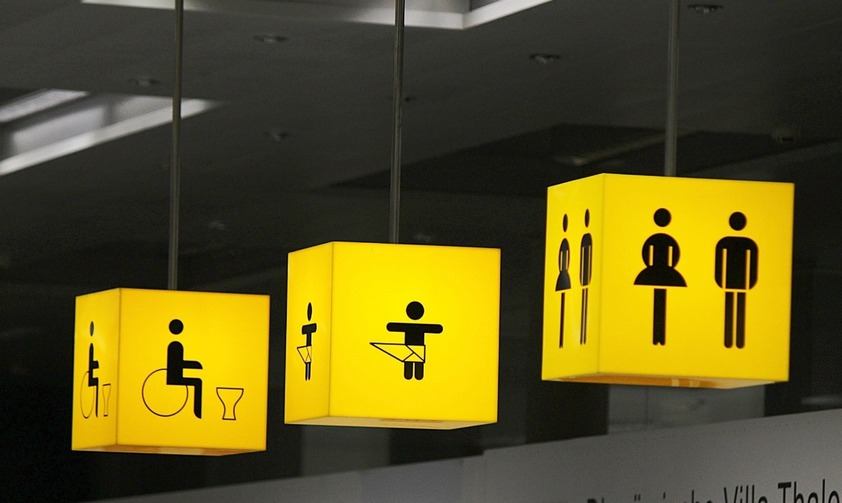
Interventions
Crowd-mapping generates geo-locative data. This is made up of points “dropped” to a precise geographical location. The data can then be analyzed and synthesized for insights, tendencies and “hotspots”.
CCTV Surveillance
Clarity of vision in open spaces
Eyes on street
Increasing activities on street
Night life of the city
Provision of shops in the vulnerable areas
Activities on street
Presence of women, children and elderly and promoting their usage through design features
Inclusion is a complex concept and difficult to define. It is not the opposite of exclusion. It is an outcome and a process, and it can be used as a tool for change. As an outcome, inclusion means that all people who use a public space feel welcome, respected, safe, and accommodat­ed—regardless of who they are, where they come from, their abilities, how old they are, or how they use the space.
Source: https://lens.monash.edu/2018/10/28/1363387/crowd-mapping-gender-equality-a-powerful-tool-for-shaping-a-better-city-launches-in-Melbourne

Slide 8
LEARNINGS
Change of notion towards a community happens only when we try to understand it.
Responding to the context; should not look like an addition
Education should have an essence of freedom and this can also be reflected through architecture.
The process of design along with the community is more important that the outcome.
Even they have the right to have sense of belongingness
A WAY FORWARD
The current social scenario has been pushing marginalized communities to a brink of breakdown. This thesis was an attempt to give them and other people an opportunity to learn and unlearn the ‘normal’ in the society. It is the people of the mainstream society who can uplift the transgender community and this typology should not be required if we stop isolating them like today.

